Slide 1
7.1 & 7.2 Using Digital Forensics Tools and Methods for Data Curation
Christopher (Cal) Lee
callee@ils.unc.edu
Kam Woods
kamwoods@email.unc.edu
June 17, 2016
Open Source Center
Reston, VA, USA
June 9-22, 2016

Slide 2
Goals When Acquiring Materials
Ensure integrity of materials
Allow users to make sense of materials and understand their context
Prevent inadvertent disclosure of sensitive data

Slide 3
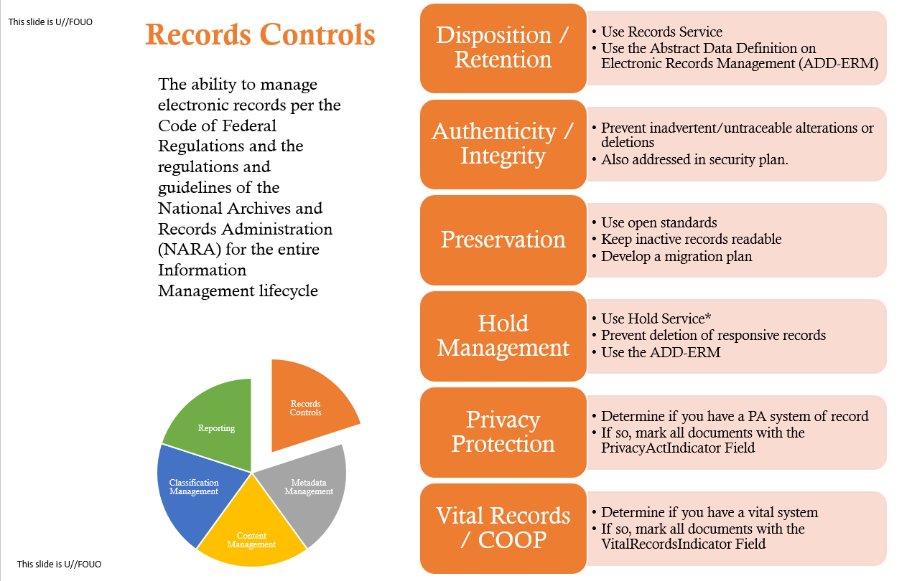
Source: “Information Management Approval Requirements.” OSC.

Slide 4
Source: “Information Management Approval Requirements.” OSC.

Slide 5
Fundamental Archival Principles
Provenance | Reflect “life history” of records Records from a common origin or source should be managed together as an aggregate unit
Original Order | Organize and manage records in ways that reflect their arrangement within the creation/use environment
Chain of Custody | “Succession of offices or persons who have held materials from the moment they were created”¹ Ideal recordkeeping system would provide “an unblemished line of responsible custody”²
Pearce-Moses, Richard. A Glossary of Archival and Records Terminology. Chicago, IL: Society of American Archivists, 2005.
Hilary Jenkinson, A Manual of Archive Administration: Including the Problems of War Archives and Archive Making (Oxford: Clarendon Press, 1922), 11.

Slide 6
Bit digital is different. See: Lee, Christopher A. “Digital Curation as Communication Mediation.” In Handbook of Technical Communication, edited by Alexander Mehler, Laurent Romary, and Dafydd Gibbon, 507-530. Berlin: Mouton De Gruyter, 2012.

Slide 7
“No computation without representation” Smith, Brian Cantwell. "Limits of Correctness in Computers." In Computerization and Controversy: Value Conflicts and Social Choices, edited by Rob Kling, 810-25. San Diego, CA: Academic Press, 1996. 815.

Slide 8
Digital Resources - Levels of Representation
Level | Label | Explanation
8 | Aggregation of objects | Set of objects that form an aggregation that is meaningful encountered as an entity
7 | Object or package | Object composed of multiple files, each of which could also be encountered as individual files
6 | In-application rendering | As rendered and encountered within a specific application
5 | File through filesystem | Files encountered as discrete set of items with associate paths and file names
4 | File as “raw” bitstream | Bitstream encountered as a continuous series of binary values
3 | Sub-file data structure | Discrete “chunk” of data that is part of a larger file
2 | Bitstream through I/O equipment | Series of 1s and 0s as accessed from the storage media using input/output hardware and software (e.g. controllers, drivers, ports, connectors)
1 | Raw signal stream through I/O equipment | Stream of magnetic flux transitions or other analog electronic output read from the drive without yet interpreting the signal stream as a set of discrete values (i.e. not treated as a digital bitstream that can be directly read by the host computer)
0 | Bitstream on physical medium | Physical properties of the storage medium that are interpreted as bitstreams at Level 1

Slide 9
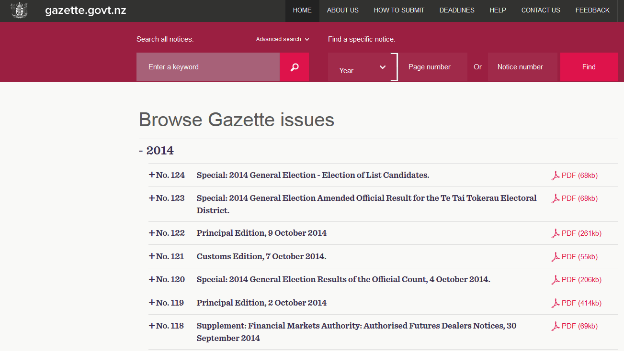
Interaction Examples
Level
Aggregation of objects
Object or package
In-application rendering
File through filesystem
File as “raw” bitstream
Sub-file data structure
Bitstream through I/O equipment
Raw signal stream through I/O equipment
Bitstream on physical medium

Slide 10
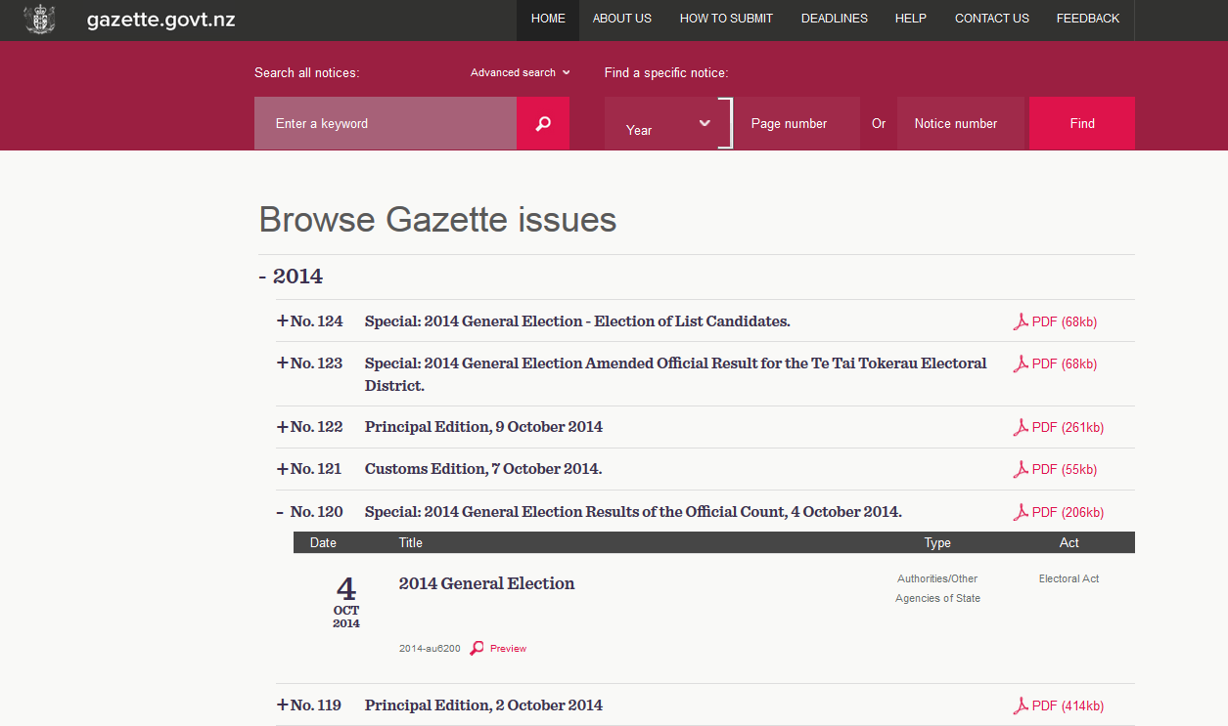
Interaction Examples
Level
Aggregation of objects
Object or package
In-application rendering
File through filesystem
File as “raw” bitstream
Sub-file data structure
Bitstream through I/O equipment
Raw signal stream through I/O equipment
Bitstream on physical medium

Slide 11
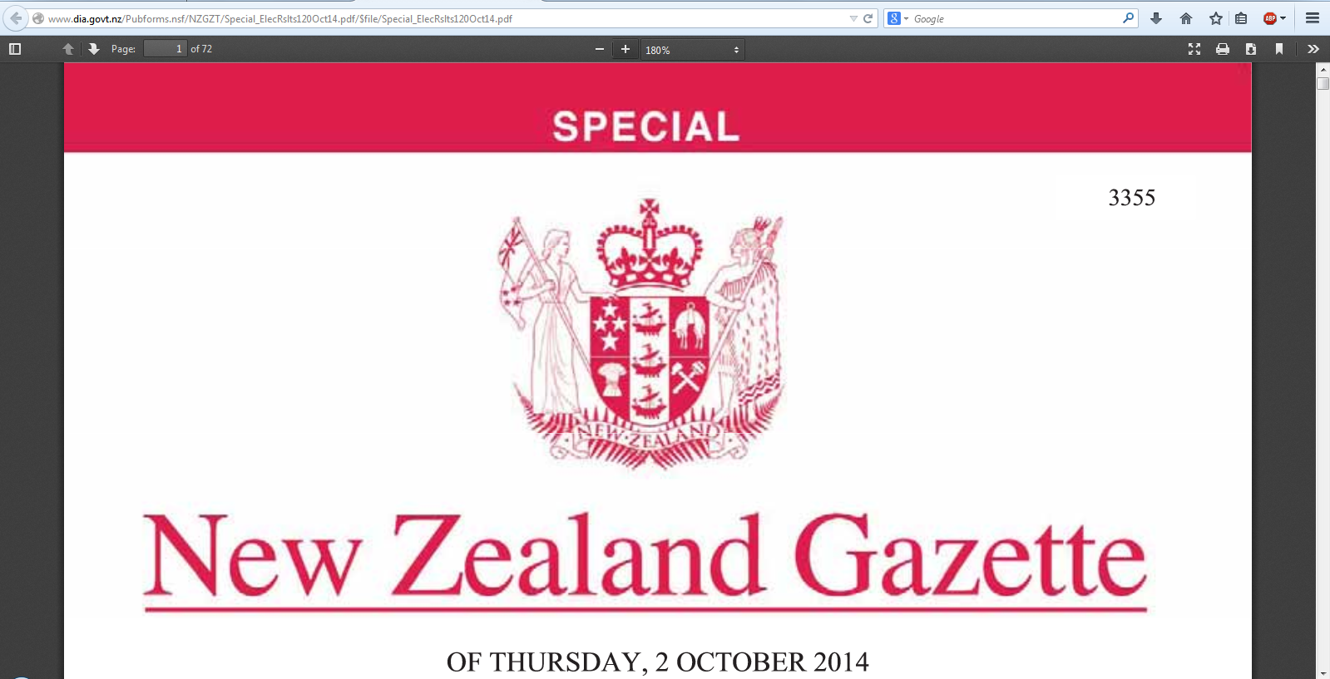
Interaction Examples
Level
Aggregation of objects
Object or package
In-application rendering
File through filesystem
File as “raw” bitstream
Sub-file data structure
Bitstream through I/O equipment
Raw signal stream through I/O equipment
Bitstream on physical medium

Slide 12
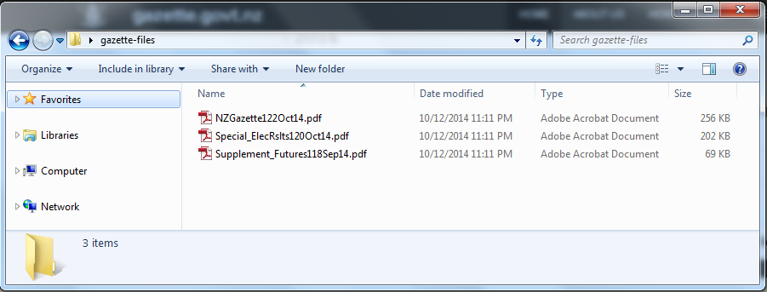
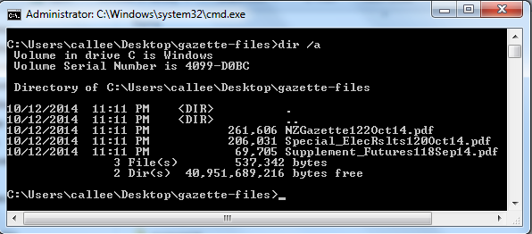
Interaction Examples
Level
Aggregation of objects
Object or package
In-application rendering
File through filesystem
File as “raw” bitstream
Sub-file data structure
Bitstream through I/O equipment
Raw signal stream through I/O equipment
Bitstream on physical medium

Slide 13
Hex Dump
A more compact and more humanly readable way of conveying a stream of bits
Uses hexadecimal notation
Each character represents one of 16 possible values (0,1,2,3,4,5,6,7,8,9,A,B,C,D,E,F)
Conveniently, a series of two characters represented in hexadecimal can represent exactly one byte (2⁸ = 256 possible values) of data, because 16² = 256
Hex dumps from computer’s memory often used for debugging or reverse engineering software and for data recovery

Slide 14
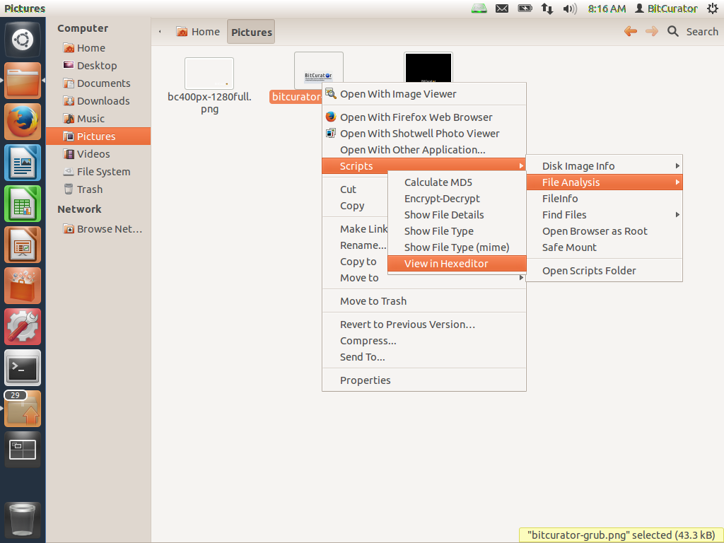
In the BitCurator environment:

Slide 15
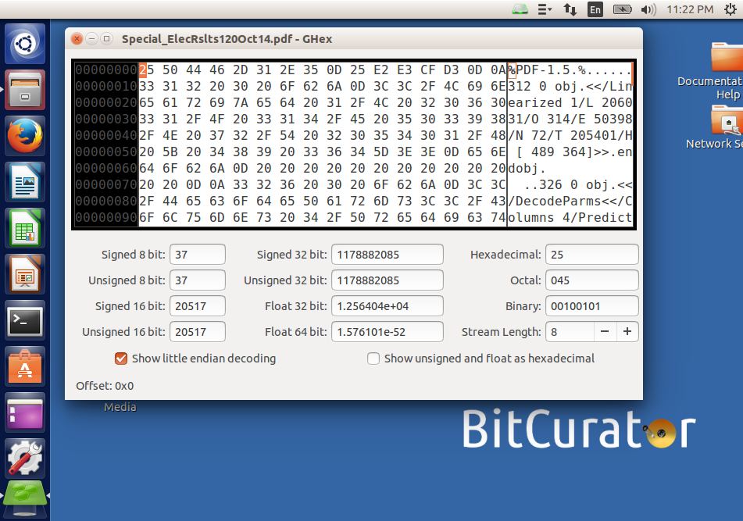
Interaction Examples
Level
Aggregation of objects
Object or package
In-application rendering
File through filesystem
File as “raw” bitstream
Sub-file data structure
Bitstream through I/O equipment
Raw signal stream through I/O equipment
Bitstream on physical medium

Slide 16
Checksums – Compact Representations of Bitstreams
A given bitstream, fed into an algorithm, will generate a short string of characters that is extremely unlikely to be generated by a different bitstream fed into that same algorithm
Most common = MD5, SHA-1
Can determine:
If bits have changed after a transfer
If bits have flipped within a storage environment
Whether two different files are identical bitstreams
A library of hash values can identify “known and notable” (EnCase terminology) files
Known – files that can be ignored (e.g. software listed in National Software Reference Library)
Notable – specific bitstreams that you’re trying to find

Slide 17
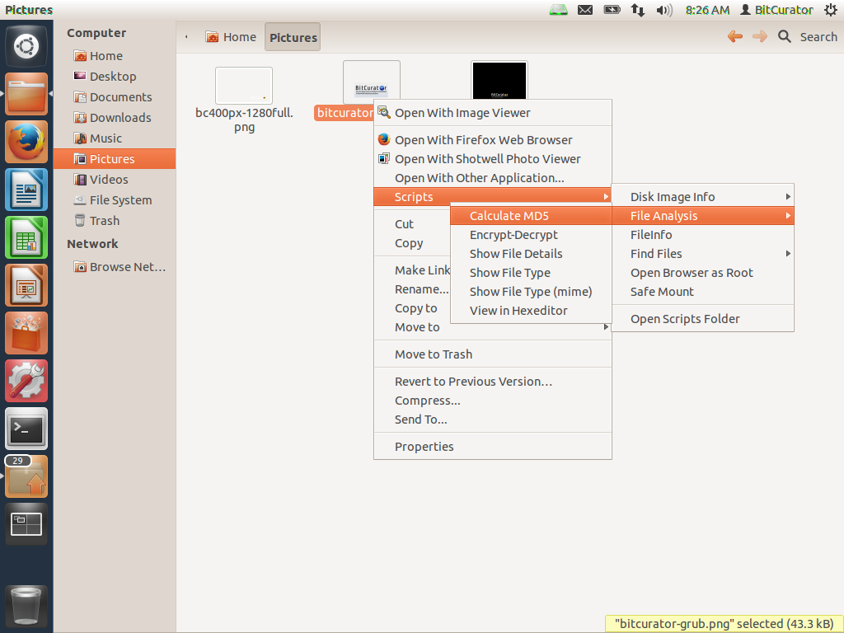
In BitCurator environment: Right Click on File or Directory and Calculate MD5

Slide 18
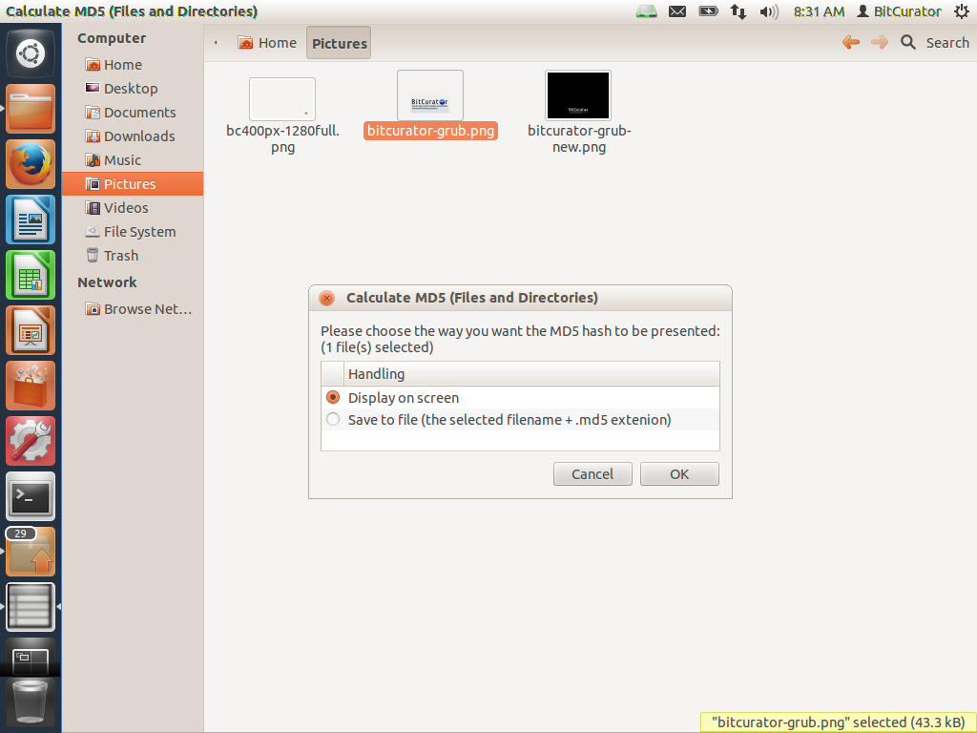

Slide 19
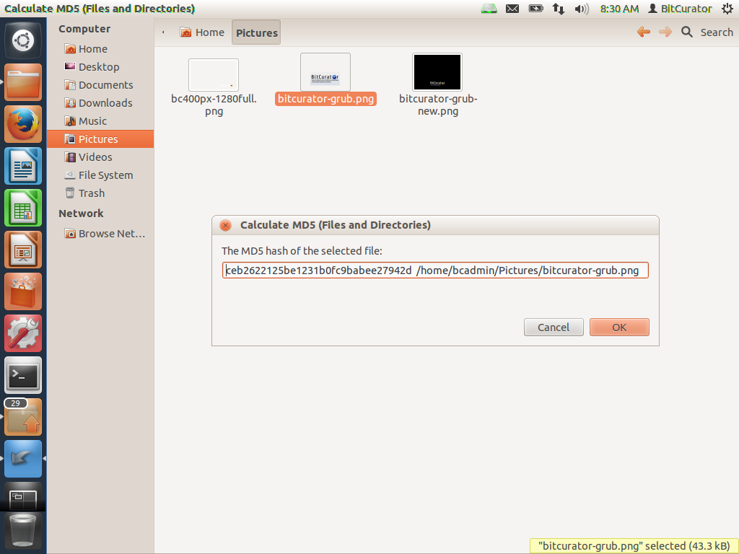

Slide 20
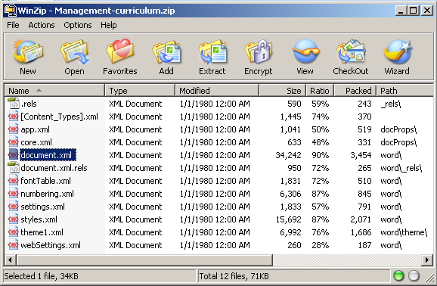
Interaction Examples
Level
Aggregation of objects
Object or package
In-application rendering
File through filesystem
File as “raw” bitstream
Sub-file data structure
Bitstream through I/O equipment
Raw signal stream through I/O equipment
Bitstream on physical medium

Slide 21
Example of EXIF Metadata from a JPEG File (Generated Using exiftool*)
---- ExifTool ----
ExifTool Version Number : 9.38
---- System ----
File Name : IMG_20130823_151811.jpg
Directory : C:/Users/callee/Documents/images/digital-forensics-lab
File Size : 1785 kB
File Modification Date/Time : 2013:08:23 16:36:44-04:00
File Access Date/Time : 2013:10:14 17:13:02-04:00
File Creation Date/Time : 2013:08:23 16:36:44-04:00
File Permissions : rw-rw-rw-
---- File ----
File Type : JPEG
MIME Type : image/jpeg
Exif Byte Order : Big-endian (Motorola, MM)
Image Width : 2592
Image Height : 1944
Encoding Process : Baseline DCT, Huffman coding
Bits Per Sample : 8
Color Components : 3
Y Cb Cr Sub Sampling : YCbCr4:2:0 (2 2)
---- GPS ----
GPS Img Direction : 83
GPS Img Direction Ref : Magnetic North
GPS Latitude Ref : North
GPS Latitude : 35 deg 55' 2.24"
GPS Longitude Ref : West
GPS Longitude : 79 deg 2' 57.55"
GPS Altitude Ref : Above Sea Level
GPS Altitude : 0 m
GPS Time Stamp : 19:18:06
GPS Processing Method : NETWORK
GPS Date Stamp : 2013:08:23
---- IFD0 ----
Orientation : Unknown (0)
Camera Model Name : Galaxy Nexus
Modify Date : 2013:08:23 15:18:11
Y Cb Cr Positioning : Centered
Y Resolution : 72
Resolution Unit : inches
X Resolution : 72
Make : Samsung
---- ExifIFD ----
Create Date : 2013:08:23 15:18:11
Date/Time Original : 2013:08:23 15:18:11
Exif Version : 0220
Flash Energy : 0
Image Unique ID : OAEL01
Exposure Time : 1/17
ISO : 125, 0, 0
Scene Type : Directly photographed
Exposure Index : undef
Components Configuration : Y, Cb, Cr, -
F Number : 2.8
Compressed Bits Per Pixel : 0
Sensing Method : One-chip color area
Exposure Program : Aperture-priority AE
Aperture Value : 2.6
Brightness Value : 0
Subject Distance Range : Unknown
Shutter Speed Value : 1/15
Subject Distance : 0 m
Saturation : Normal
Color Space : sRGB
Contrast : Normal
Metering Mode : Multi-spot
Flashpix Version :
Exposure Compensation : 0
Exif Image Height : 1944
Max Aperture Value : 2.6
Sharpness : Normal
Exif Image Width : 2592
Focal Length : 3.4 mm
Digital Zoom Ratio : 1
Light Source : Fluorescent
Scene Capture Type : Standard
Flash : Off, Did not fire
Custom Rendered : Custom
White Balance : Auto
Exposure Mode : Auto
---- IFD1 ----
Compression : JPEG (old-style)
Image Width : 160
Image Height : 120
Thumbnail Offset : 1239
Thumbnail Length : 7164
---- Composite ----
Aperture : 2.8
GPS Altitude : 0 m Above Sea Level
GPS Date/Time : 2013:08:23 19:18:06Z
GPS Latitude : 35 deg 55' 2.24" N
GPS Longitude : 79 deg 2' 57.55" W
GPS Position : 35 deg 55' 2.24" N, 79 deg 2' 57.55" W
Image Size : 2592x1944
Shutter Speed : 1/17
Thumbnail Image : (Binary data 7164 bytes, use -b option to extract)
Focal Length : 3.4 mm
Light Value : 6.7
*http://www.sno.phy.queensu.ca/~phil/exiftool/ (Also available through the BitCurator environment)

Slide 22
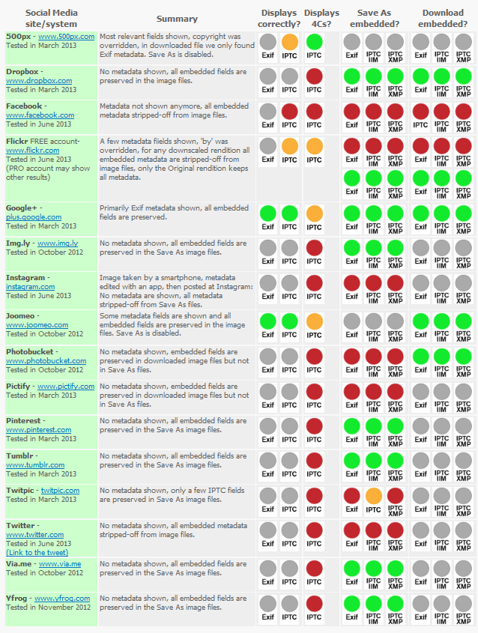
Stripping of Metadata from Images
http://www.embeddedmetadata.org/social-media-test-results.php

Slide 23
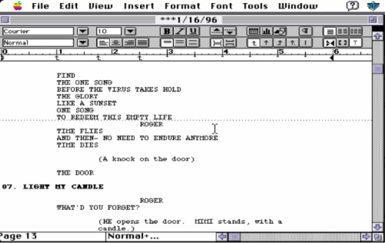
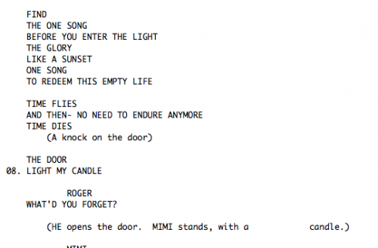
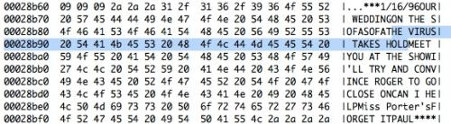
Jonathan Larson Fast Save Example
http://www.nypl.org/blog/2011/04/22/no-day-today-look-jonathan-larsons-word-files

Slide 24
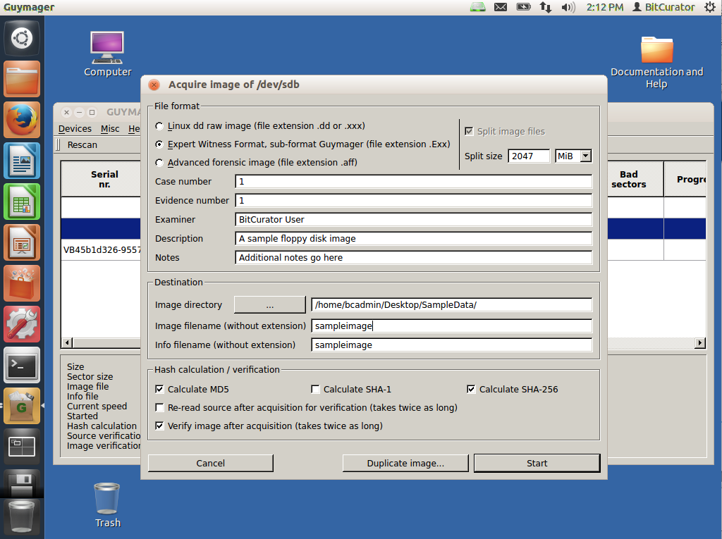
Interaction Examples
Level
Aggregation of objects
Object or package
In-application rendering
File through filesystem
File as “raw” bitstream
Sub-file data structure
Bitstream through I/O equipment
Raw signal stream through I/O equipment
Bitstream on physical medium

Slide 25
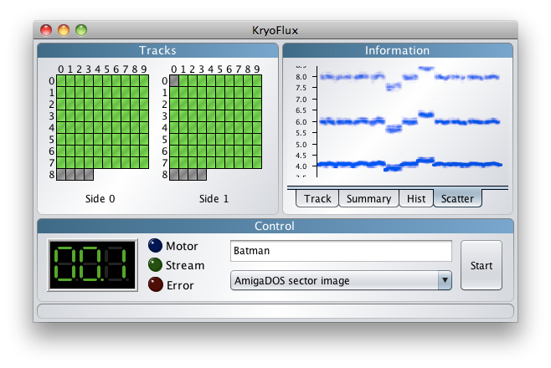
Interaction Examples
Level
Aggregation of objects
Object or package
In-application rendering
File through filesystem
File as “raw” bitstream
Sub-file data structure
Bitstream through I/O equipment
Raw signal stream through I/O equipment
Bitstream on physical medium

Slide 26
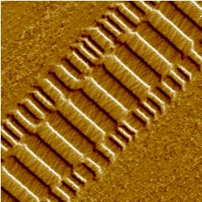
Interaction Examples
Level
Aggregation of objects
Object or package
In-application rendering
File through filesystem
File as “raw” bitstream
Sub-file data structure
Bitstream through I/O equipment
Raw signal stream through I/O equipment
Bitstream on physical medium
Veeco Instruments. http://www.veeco.com/library/nanotheater_detail.php?type=application&id=78&app_id=34

Slide 27
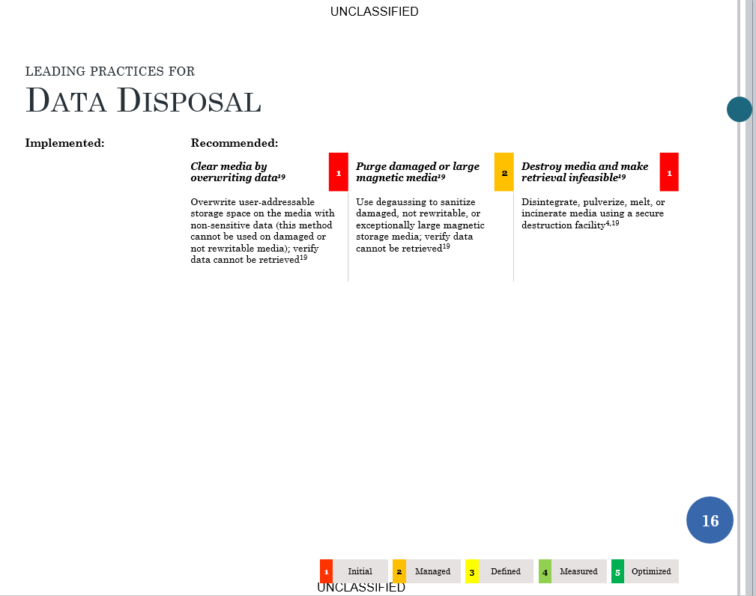
Source: Data Management Leading Practices. OSC, 6/26/2015

Slide 28
Digital Resources - Levels of Representation
Level | Label | Explanation
8 | Aggregation of objects | Set of objects that form an aggregation that is meaningful encountered as an entity
7 | Object or package | Object composed of multiple files, each of which could also be encountered as individual files
6 | In-application rendering | As rendered and encountered within a specific application
5 | File through filesystem | Files encountered as discrete set of items with associate paths and file names
4 | File as “raw” bitstream | Bitstream encountered as a continuous series of binary values
3 | Sub-file data structure | Discrete “chunk” of data that is part of a larger file
2 | Bitstream through I/O equipment | Series of 1s and 0s as accessed from the storage media using input/output hardware and software (e.g. controllers, drivers, ports, connectors)
1 | Raw signal stream through I/O equipment | Stream of magnetic flux transitions or other analog electronic output read from the drive without yet interpreting the signal stream as a set of discrete values (i.e. not treated as a digital bitstream that can be directly read by the host computer)
0 | Bitstream on physical medium | Physical properties of the storage medium that are interpreted as bitstreams at Level 1
Levels where digital forensics methods and tools can provide the most assistance

Slide 29
Three Complicating Factors for Collecting Institutions: Medium Failure / Bit Rot Obsolescence Volatility

Slide 30
Bit Rot
Preventing measures can help (proper storage and handling), but bits on a given medium will eventual flip or become unreadable
Bit rot and advantages of newer media both call for periodic refreshing and reformatting
Ensuring the integrity of the bit stream when transferring from one medium to another is extremely important

Slide 31
Obsolescence
“Obsolete power corrupts obsoletely.”
- Ted Nelson
The technology associated with interpreting the representation at each of the layers can change or become less available

Slide 32
Order of Volatility
Some types of data change much more quickly and often than others
Important to recognize in order to recover data from a computer system or media, while ensuring that actions don’t make irreversible changes to their record characteristics
Example: If the contents of the browser cache are important to you, capture the cache before using the browser

Slide 33
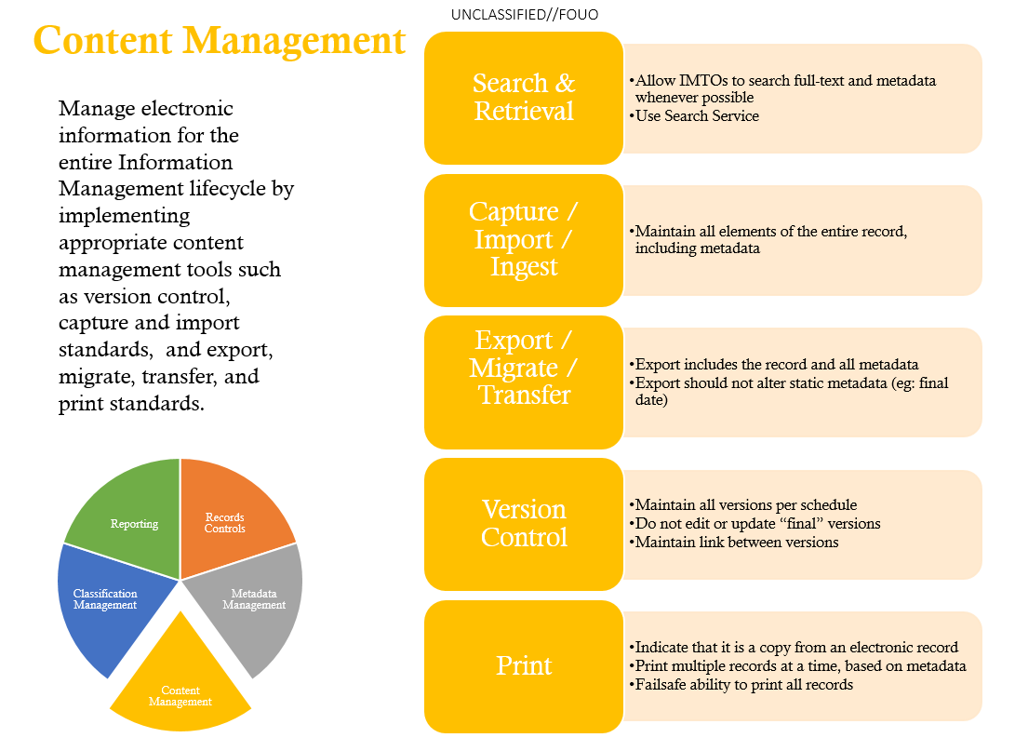
Source: “Information Management Approval Requirements.” OSC.

Slide 34
Source: “Information Management Approval Requirements.” OSC.

Slide 35
File System – An Essential Layer for Metadata
Access controls
File names & identifiers
File size (length)
Where to find files in storage (sectors and clusters)
MAC times
Modified – when the content was last changed
Accessed – time file was last accessed (by person or software)
Changed – last time metadata changed
Created – (implemented inconsistently, if at all, across different file systems)

Slide 36
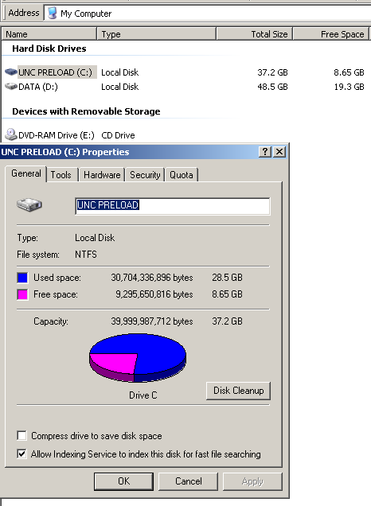

Slide 37
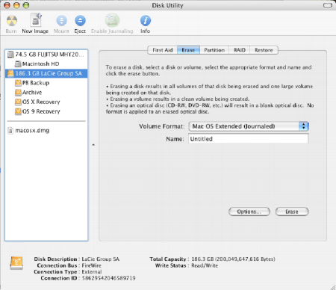
This is HFS+
Source for underlying screenshot: “How to Use 1 External Drive between Mac and PC,” nicknack, February 5, 2007, http://www.gigacrate.com/Articles/?p=53

Slide 38
File System Examples
Name | Operating System(s) Using it as Native File System [often other OSs can also recognize it]
FAT12, FAT16 | MS-DOS
FAT32 (VFAT) | Windows 95, 98
exFAT | Windows XP SP2 and later (primary use: USB drives, SD cards)
NTFS | Windows NT, 2000, XP, Server 2003, Server 2008, Vista
MFS | Macintosh System 1-3
HFS (Hierarchical File System) | Macintosh System 4-8
HFS+ | Macintosh System 8.1 – 9, OS X 10.0 – 10.11
APFS | macOS 10.12
ext, ext2, ext3, ext4 (Extended File System) | Linux
XFS | Linux, typically Enterprise variants (RHEL)
HPFS (High Performance File System) | OS/2
ISOFS (ISO 9660) | Any OS that reads data from a CD
JFS1 (Journaled File System) | AIX (IBM)
ReiserFS | Several Linux distributions
UFS (Unix File System) aka FFS (Fast File System) | Various flavors of Unix

Slide 39
File System Examples
Name | Operating System(s) Using it as Native File System [often other OSs can also recognize it]
FAT12, FAT16 | MS-DOS
FAT32 (VFAT) | Windows 95, 98
exFAT | Windows XP SP2 and later (primary use: USB drives, SD cards)
NTFS | Windows NT, 2000, XP, Server 2003, Server 2008, Vista
MFS | Macintosh System 1-3
HFS (Hierarchical File System) | Macintosh System 4-8
HFS+ | Macintosh System 8.1 – 9, OS X 10.0 – 10.11
APFS | macOS 10.12
ext, ext2, ext3, ext4 (Extended File System) | Linux
XFS | Linux, typically Enterprise variants (RHEL)
HPFS (High Performance File System) | OS/2
ISOFS (ISO 9660) | Any OS that reads data from a CD
JFS1 (Journaled File System) | AIX (IBM)
ReiserFS | Several Linux distributions
UFS (Unix File System) aka FFS (Fast File System) | Various flavors of Unix
Filesystems you’re most likely to encounter

Slide 40
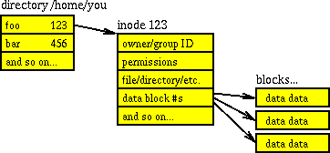
File Systems for Unix
Source: Farmer, Dan, and Wietse Venema. Forensic Discovery. Upper Saddle River, NJ: Addison-Wesley, 2005. Figure 3.2: Simplified structure of the UNIX file system

Slide 41
Microsoft File Systems: FAT and NTFS

Slide 42
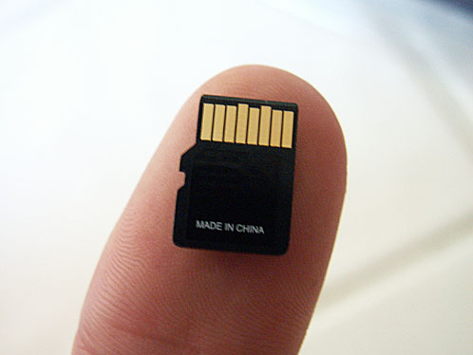
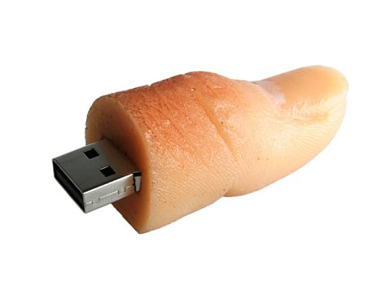
FAT
Supported by all versions of Windows and most versions of UNIX
Common in many removable media, e.g. thumb drives, memory cards
http://mono-for-android.1047100.n5.nabble.com/detect-SD-Card-path-td5710218.html
http://www.ubergizmo.com/2008/09/usb-thumb-drive/

Slide 43
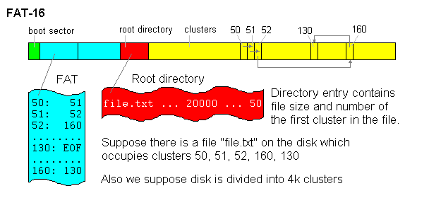
Source: Mikhail, Ranish. “Partitioning Primer.” August 5, 1998. http://www.ranish.com/part/primer.htm

Slide 44
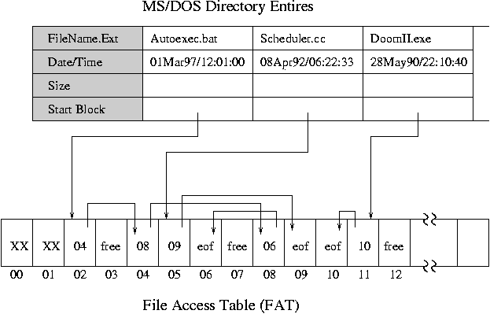
Source: Duong, Duc. "I/O devices and File systems." Vietnam OpenCourseWare. November 18, 2008. http://www.vocw.edu.vn/content/m10107/1.3/.

Slide 45
What Happens When a File is Deleted from a Directory

Slide 46
What Happens When a File is Deleted from a Directory
E5utoExec.bat
Directory entry is marked as deleted, by replacing first character of the file name with a hex value of E5.

Slide 47
What Happens When a File is Deleted from a Directory
_utoExec.bat
E5utoExec.bat
In the FAT, pointers to the clusters containing this file’s data are marked as “free.”
free
free
free
free

Slide 48
What Happens When a File is Deleted from a Directory
_utoExec.bat
E5utoExec.bat
Data from the deleted file will remain in these clusters, until they’re over-written with data that is later allocated to those same clusters.
free
free
free
free

Slide 49
NTFS
Directory and FAT functions are combined in the Master File Table ($MFT)
Each MFT record is assigned a unique number
Good for forensic discovery:
For small files (< about 600 bytes), content is stored directly in the MFT itself & remains until overwritten by another MFT record
Not so good for forensic discovery:
After deletion of a file, NTFS replaces (overwrites) the MFT record the next time a new file is created

Slide 50
“Archive” Formats as Portable File Systems
Most popular: zip and tar
Retain important metadata that was in original file system, but does add a layer of representation information (compression & packaging) that software needs to understand
Compression also reduces robustness in the face of bit loss (any given bit flip is more likely to prevent recovery/rendering of content)

Slide 51
Some changes you might want to make to the computer you’re using to process born-digital materials – making yourself a more powerful user

Slide 52
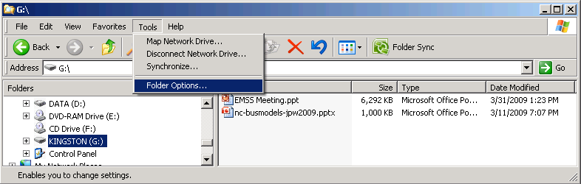
Show “Hidden” Files and Folders

Slide 53
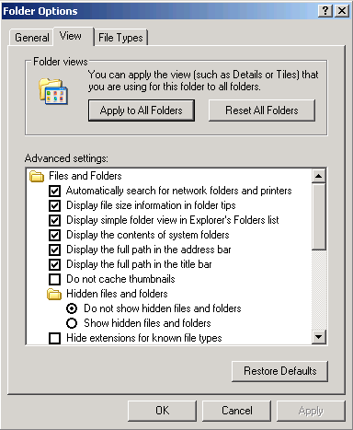

Slide 54
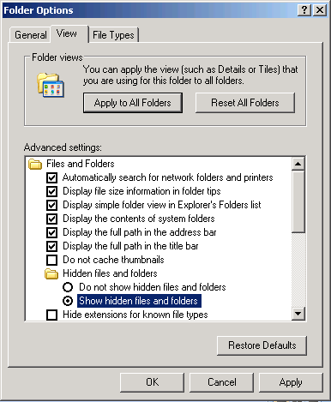

Slide 55
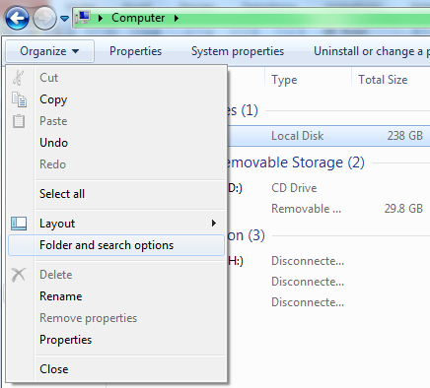
Previous screenshots were from an older version of Windows. On a later version, you’ll probably see something like this instead:

Slide 56
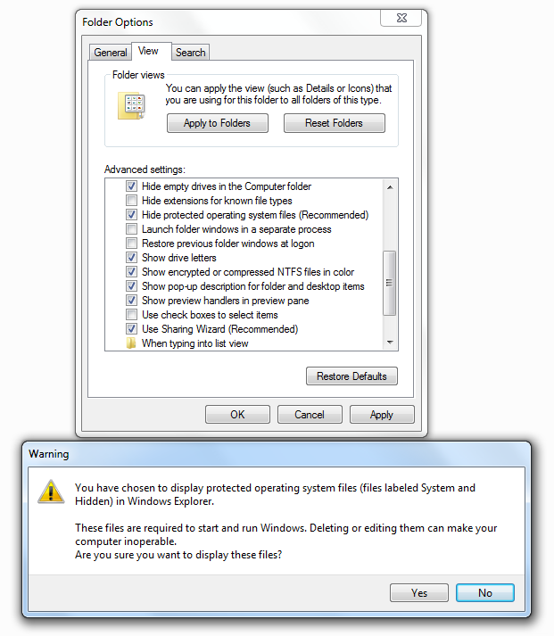
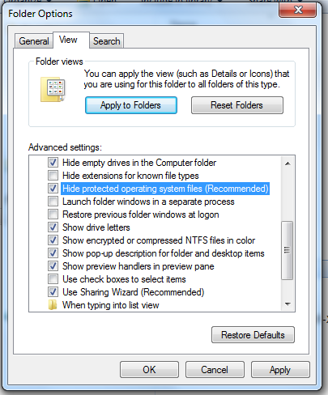
Show “protected” system files that are normally hidden from the user:

Slide 57
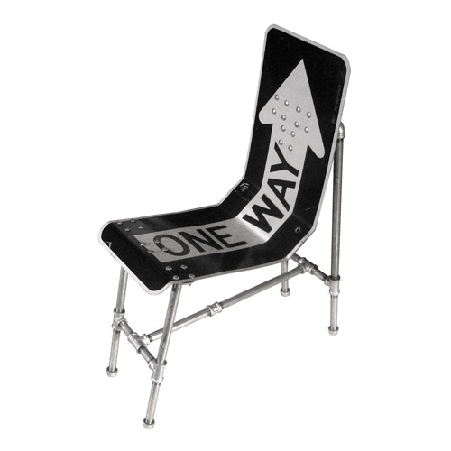
Write Blocking – One-Way Streets for Data
Ensures that data can be read from the device, but no bits can be changed
Doesn’t just prevent changes consciously made by user but also changes made by the system
Options for write blocking (in order of most to least certain to prevent writes to the drive):
Dedicated write blockers
Writing blocking tabs or settings
on the device itself
Software-based write blocking
Image source: http://thinng.com/1555-one-way-sign-seat

Slide 58
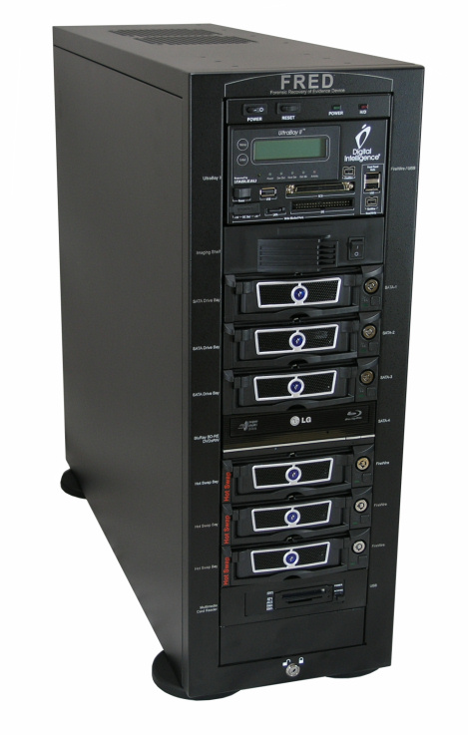
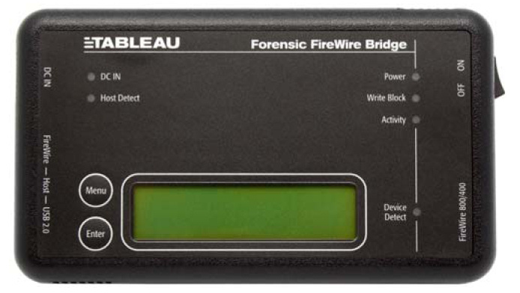
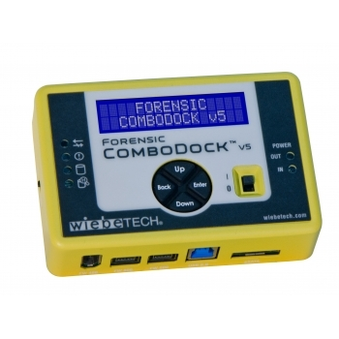
Dedicated Hardware Write Blockers

Slide 59
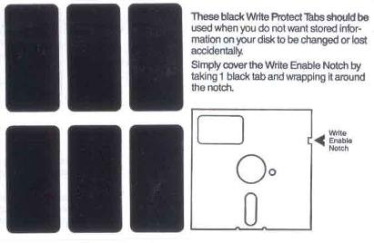
5.25 Inch Floppy – If light can get through, it’s not write protected
http://en.wikipedia.org/wiki/File:Floppy_tabs_3x2.jpg

Slide 60
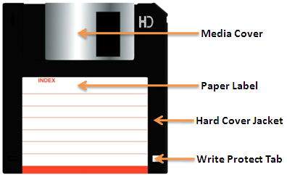
3.5 Inch Floppy – If light can get through, it is write protected
http://www.techmint.info/2009/09/security-write-protecting-floppy-disks.html

Slide 61
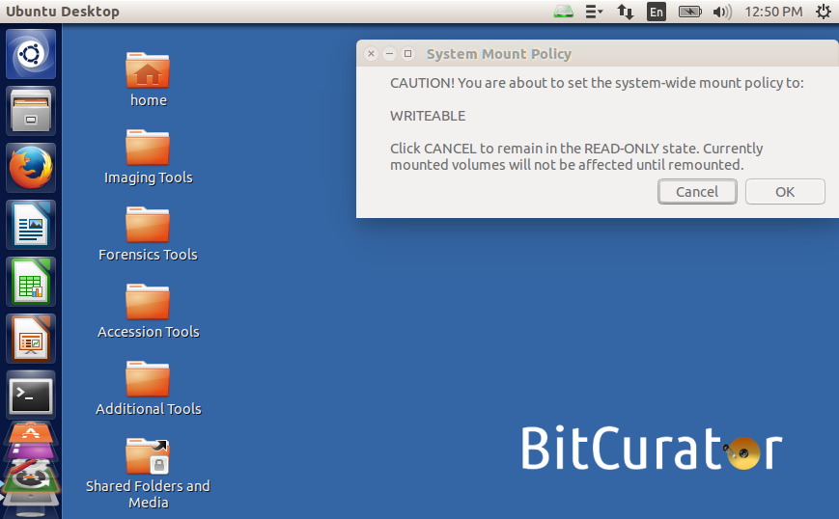
Example of Software Write Blocking – Mounted Devices set to Read-Only by Default

Slide 62
Floppy Disks
Physical storage is similar to hard drives described above (magnetic charges in a spinning disk)
Various types and sizes, e.g. high density, double density, 3.5 inch, 5.25 inch, 8 inch
3.5 inch floppies are relatively easy to read using a USB drive, but older ones are more complicated…

Slide 63
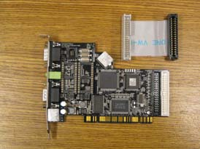
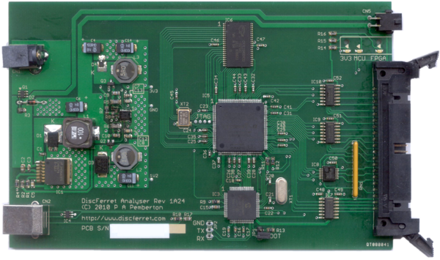
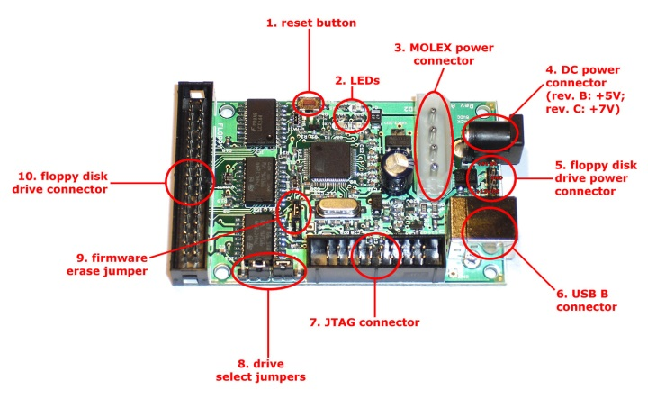
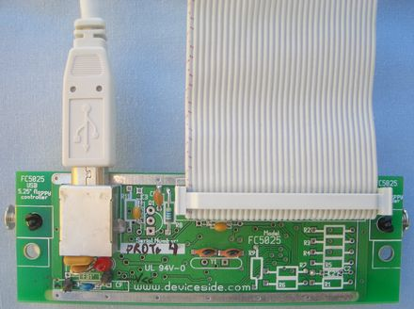
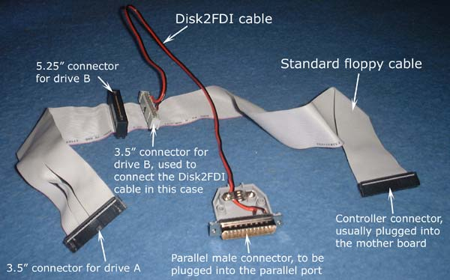
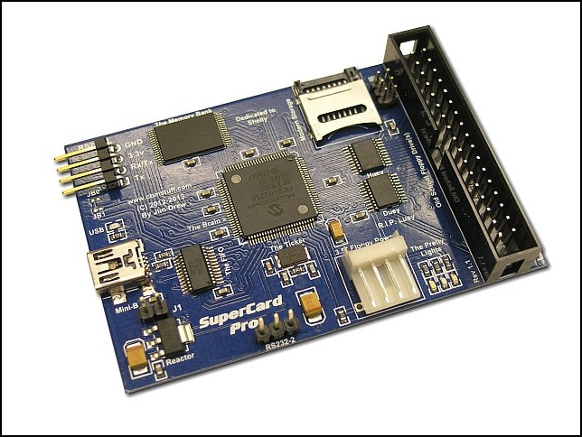
Floppy Controller Hardware
CatWeasel¹ (no longer available)
Kryoflux³
Disc Ferret²
Disk2FDI⁵
SuperCard Pro⁶
FC 5025⁴
http://lib.stanford.edu/digitial-forensics-stanford-university-libraries/catweasel-universal-floppy-drive-controller
http://discferret.com/wiki/DiscFerret
http://www.kryoflux.com/
http://www.deviceside.com/fc5025.html
http://disk2fdi.joguin.com/D2FCABLE.htm
http://www.cbmstuff.com/proddetail.php?prod=SCP

Slide 64
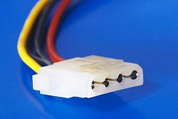

Two Important Considerations for Internal Media that are Used as External Media
Power - internal drive needs different connector (often Molex), not the kind that plugs into the wall
Cooling – when pulled from the computer, you’ve also separated the drive from the fan, so you should often add an external one to ensure cooling
http://en.wikipedia.org/wiki/File:Molex_female_connector.jpg
http://www.tigerdirect.com/applications/SearchTools/item-details.asp?EdpNo=1648567

Slide 65
Getting below the File System – Low-Level Copying
Getting an “image” of a storage medium involves working at a level below the file system
Can get at file attributes and deleted files not visible through higher-level copy operations
Most commonly used tool is dd (or variant) - UNIX program for low-level copying and conversion of data from a storage device
More specialized tools for creating forensic images include:
aimage
dc3dd and dcfldd (based on dd)
FTK Imager
Guymager
Imaging utilities in commercial applications (including EnCase and FTK)

Slide 66
What is Digital Forensics (aka Forensic Computing)?
“The process of identifying, preserving, analysing and presenting digital evidence in a manner that is legally acceptable.”*
“Involves multiple methods of
Discovering digital data (computer system, mobiles)
Recovering deleted, encrypted, or damaged file information
Monitoring live activity
Detecting violations of corporate policy”**
*McKemmish, R. “What is Forensic Computing?” Trends and Issues in Crime and Criminal Justice 118 (1999).
**Brad Glisson, Introduction to Computer Forensics & E-discovery, University of Glasgow, Week 1 Lecture, September 2008. (emphasis mine)

Slide 67
Digital Forensics Industry and Tools
Examples of commercial products:
EnCase (Guidance Software)
FTK (AccessData)
Various open source tools – see: http://www.forensicswiki.org

Slide 68
Using Digital Forensics to Advance Data Curation Goals
In recent years, institutions responsible for data curation have been applying various digital forensics methods, for example:
use of write blockers
generation of disk images
applying cryptographic hashes to files
capture of Digital Forensics XML (DFXML)
scanning bitstreams for personally identifying information

Slide 69
Need for Adaptation of Digital Forensics Tools and Tasks
Existing digital forensics tools provide valuable functionality, but they don’t always fit well into primary data curation workflows.
For example:
structure and persistence of metadata
provisions for providing public access to data
support for older technologies (e.g. floppy disks, HFS)

Slide 70
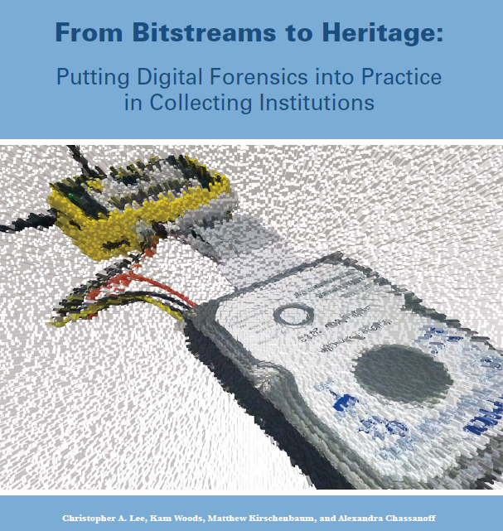
http://www.bitcurator.net/docs/bitstreams-to-heritage.pdf

Slide 71
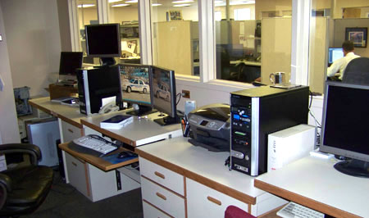
Digital forensics tools are designed primarily to be used in places like this:
El Paso County Sheriff’s Office (Colorado) http://shr.elpasoco.com/Law+Enforcement+Bureau/Investigations+Division/Computer+Crime+Lab.htm

Slide 72
But they’re also being used in places like this:

Slide 73

Stanford University Libraries and Academic Information Resources (SULAIR)

Slide 74


British Library, London

Slide 75

UNC School of Information and Library Science

Slide 76

Porter Olsen, Building a Digital Curation Workstation with BitCurator (update)
http://www.bitcurator.net/building-a-digital-curation-workstation-with-bitcurator-update/

Slide 77

Outfitting a Born-Digital Archives Program
Ben Goldman, Penn State University
http://practicaltechnologyforarchives.org/issue2_goldman/

Slide 78

Funded by Andrew W. Mellon Foundation
Phase 1: October 1, 2011 – September 30, 2013
Phase 2 – October 1, 2013 – September 30, 2014
Partners: School of Information and Library Science (SILS) at UNC and Maryland Institute for Technology in the Humanities (MITH)

Slide 79
BitCurator Goals
Develop a system for collecting professionals that incorporates the functionality of open-source digital forensics tools
Address two fundamental needs not usually addressed by the digital forensics industry:
incorporation into the workflow of archives/library ingest and collection management environments
provision of public access to the data

Slide 80

http://www.bitcurator.net/wp-content/uploads/2014/11/code-to-community.pdf

Slide 81
BitCurator Environment*
Bundles, integrates and extends functionality (primarily data capture and reporting) of open source software: fiwalk, bulk extractor, Guymager, The Sleuth Kit, sdhash and others
Can be run as:
Self-contained environment (based on Ubuntu Linux) running directly on a computer (download installation ISO)
Self-contained Linux environment in a virtual machine using e.g. Virtual Box or VMWare
As individual components run directly in your own Linux environment or (whenever possible) Windows environment
*To read about and download the environment, see: http://wiki.bitcurator.net/

Slide 82

“Open Source Tools for Records Management,” NARA/OMB M-12-18, Managing Government Records Directive Reporting on Requirement A3.2, National Archives and Records Administration, March 18, 2015.

Slide 83

Most of the tasks we cover in this class are explained in the Quick Start Guide. The most recent version always available at: http://wiki.bitcurator.net/

Slide 84
BitCurator Consortium
Continuing home for hosting, stewardship and support of BitCurator (and BitCurator Access) tools and associated user engagement
Administrative home: Educopia Institute
Funding based on membership dues
Institutions as members, with two categories of membership: Charter and General
The most important member benefit is assurance that the BitCurator software will persist in future years
http://www.bitcurator.net/bitcurator-consortium/

Slide 85


Slide 86

BitCurator-Supported Workflow
Acquisition
Reporting
Redaction
Metadata Export
See: http://bitcurator.net

Slide 87
Getting below the File System – Low-Level Copying
Getting an “image” of a storage medium involves working at a level below the file system
Can get at file attributes and deleted files not visible through higher-level copy operations
Most commonly used tool is dd (or variant) - UNIX program for low-level copying and conversion of data from a storage device
More specialized tools for creating forensic images include:
FTK Imager
Guymager
Imaging utilities in commercial applications (e.g. EnCase)

Slide 88

Main Acquisition Interface for Guymager

Slide 89


Slide 90


Slide 91
Two Ways to Interact with Disk Images
Mount them like regular drives:
Disk Utility in Mac OS X (for ISO images)
ewfmount
MagicDisc (for ISO images)
OSFMount
BitCurator (mounting scripts built into the environment)
Inspect them as forensic objects
FTK Imager
The Sleuth Kit (TSK)
BitCurator (Disk Image Access tool)

Slide 92


Mounting a Forensically Packaged Disk Image in the BitCurator Environment

Slide 93


Exporting Files from a Disk Image

Slide 94

Identifying Potentially Sensitive Data using Bulk Extractor - Scanning Options
See: http://www.forensicswiki.org/wiki/Bulk_extractor

Slide 95

Histogram of Email Addresses (Specific Instances in Context on Right)

Slide 96

SSNs and DOBs identified in large PST collection using bulk_extractor

Slide 97

Exporting Filesystem Content Using fiwalk

Slide 98

Provenance metadata - about the disk capture process
Technical metadata - about the specific storage partition(s) on the disk

Slide 99

Exporting Filesystem Metadata - Output from fiwalk (XML)

Slide 100

https://github.com/dfxml-working-group/dfxml_schema

Slide 101

High-Level view of Metadata Generation and Reporting
See: Woods, Kam, Christopher Lee, and Sunitha Misra. “Automated Analysis and Visualization of Disk Images and File Systems for Preservation.” In Proceedings of Archiving 2013 (Springfield, VA: Society for Imaging Science and Technology, 2013), 239-244.

Slide 102

PREMIS (Preservation) Metadata Generated from Running BitCurator Tools – Recorded as PREMIS Events

Slide 103

Various Specialized BitCurator Reports

Slide 104
Specialized BitCurator Reports
File | Content
bc_format_bargraph.pdf | histogram of file formats found on the volume
bulk_extractor_report.pdf | high-level overview of feature locations on disk
fiwalk_deleted_files.pdf | shows paths to any deleted materials found in a given partition
fiwalk-output.xml.xlsx | Excel converted DFXML output (file system metadata)
fiwalk_report.pdf | high-level overview of file system characteristics
format_table.pdf | long-form file format names for formats shown in bar graph
premis.xml | PREMIS preservation metadata

Slide 105
Other Functionality to Meet Identified User Needs:
Function | Tool(s)
Identify duplicate files | FSLint
Characterize files | FITS, FIDO
Scan for viruses | ClamTK
Examine, copy and extract information from old Mac disks | HFS Utilities (including HFS Explorer)
Capture AV file metadata | MediaInfo, FFProbe
Extract text from older binary (.doc) Word files | antiword
Read contents of Mircosoft Outlook PST files | readpst
Examine embedded header information in images | pyExifToolGUI
Generate images of problematic disks or particular disk types | dd, dcfldd, ddrescue, cdrdao (in addition to Guymager)
Extract and analyze data from Windows Registry files | regripper
Identify files that are partially similar but not identical | sdhash, ssdeep
Package files for storage and/or transfer | BagIt (Java) library, Bagger
File preview (left-click on file then hit space bar) | gnome-sushi
Play and examine metadata from AV media files | VLC media player
Damaged/lost partition recovery | TestDisk
Damaged/lost file recovery | PhotoRec
Identify the filesystem on a disk | disktype
Index and search for keywords in documents | recoll
Find blacklist data by using hashes calculated from hash blocks | hashdb
Generate hashes of files and blocks | md5deep (more features than md5sum)

Slide 106

Command Line Operations – Open Up Many More Possibilities
stringing tools together
performing batch operations
changing parameters from their default values
using tools that are only available through the command line (no GUI)

Slide 107
End User Access Scenarios
Virtualization and emulation
Mounting the original filesystem
Accessing (but not mounting) disk images using forensics software
Remote, dynamic access to disk image contents
Cross-drive analysis

Slide 108
Two-year project (October 1, 2014 – September 30, 2016) at School of Information and Library Science, University of North Carolina at Chapel Hill
Funded by Andrew W. Mellon Foundation
Developing open-source software to support access to disk images. Core areas of focus:
Tools and reusable libraries to support web access services for disk images
Analyzing contents of file systems and associated metadata
Redacting complex born-digital objects (disk images)
Emulated access to data from disk images

Slide 109




BitCurator Access Team
Cal Lee
Principal investigator
Alex Chassanoff Project Manager
Kam Woods Technical Lead and Co-PI
Sunitha Misra Software Developer

Slide 110

BitCurator Access Advisory Board
Geoffrey Brown, Indiana University
Mark Evans, History Associates
Erika Farr, Emory University
Matthew Farrell, Duke University
Brad Glisson, University of South Alabama
Matthew Kirschenbaum, Maryland Institute for Technology in the Humanities
Susan Malsbury, New York Public Library
Don Mennerich, New York University
Klaus Rechert, University of Freiburg
Kari Smith, Massachusetts Institute of Technology
Bradley Westbrook, ArchivesSpace
Doug White, National Institute of Standards and Technology
Carl Wilson, Open Planets Foundation

Slide 111

Automated Redaction and Access Options
EaaS = Emulation-as-a-Service. http://bw-fla.uni-freiburg.de/

Slide 112
Automated Redaction and Access Options
EaaS = Emulation-as-a-Service. http://bw-fla.uni-freiburg.de/

Slide 113
BCA (BitCurator Access) Web Tools
Integrates digital forensics software libraries and lightweight web-services tools
Drop disk images in a local or network-accessible location, start up the service, and start browsing
Most analysis runs server-side (via Sleuthkit and DFXML Python bindings, among others)
Service is database-agnostic (we’re using postgres)
Automatic metadata production – Digital Forensics XML (DFXML), PREMIS, others)
https://github.com/kamwoods/bca-webtools
Sunitha Misra, Christopher A. Lee, and Kam Woods, “A Web Service for File-Level Access to Disk Images,” Code4Lib Journal 25 (2014), http://journal.code4lib.org/articles/9773

Slide 114


Slide 115


Slide 116


Slide 117


Slide 118

Source: Simson L. Garfinkel, “Forensic Feature Extraction and Cross-Drive Analysis,” Digital Forensics Research Workshop, August 15, 2006.

Slide 119
Audiovisual Forensics
Traditionally has relied on specialized commercial software suites
Metadata extraction, stills and/or relevant content extraction, enhancement
Problems:
Much content produced by consumer-grade equipment in proprietary video and audio formats
Significant compute power required to process quickly
Software licenses can be prohibitively priced
Asking investigators to watch hours of video or listen to hours of audio to identify relevant content may be impractical or undesirable
Recent additions to Autopsy (and other open source platforms) allow investigators to perform many of the desired operations with a mix of open source and proprietary (but free-cost) software

Slide 120

Screenshot of some video footage being played in VLC
Next: Ingest this footage as a logical file into Autopsy to extract metadata and keyframes

Slide 121

Starting up Autopsy…

Slide 122

Similar to commercial forensics suites, Autopsy is case based. A new case must be created in order to add and analyze files or disk images

Slide 123

Entering case information…

Slide 124

Entering case information…

Slide 125

Adding data sources. In this case, just our single video file. An examiner would typically add a collection of related materials, here.

Slide 126

Autopsy has a default set of modules that it runs by default. We can disable the modules that aren’t applicable to the materials being processed here (they can be reenabled later if needed).

Slide 127

Ingest and analysis may take some time. The progress bar in the bottom right indicates the current status

Slide 128

Selecting the appropriate file from “Data Sources” (top left) and the “Video Triage” tab in the bottom right buffers in the video and extracts key frames.

Slide 129

Expanded view of the available keyframes.

Slide 130

Selecting “View Images/Video” from the Tools menu provides views for grouping and categorizing materials, and per-item metadata. We’ll take a look at this in the actual application…

Slide 131



BitCurator, BitCurator Consortium and BitCurator Access Resources
Get the software
Documentation and technical specifications
Screencasts
Google Group
http://wiki.bitcurator.net/
People
Project overview
Publications
News
http://www.bitcurator.net/
BitCurator Access Project and Products
http://access.bitcurator.net/
Twitter: @bitcurator

Slide 132
Incorporating digital forensics into institutional workflows

Slide 133

Storage Media Acquisition and Handling Profile for Digital Repositories*
*Woods, Kam, Christopher A. Lee, and Simson Garfinkel. “Extending Digital Repository Architectures to Support Disk Image Preservation and Access.” In JCDL '11: Proceeding of the 11th Annual International ACM/IEEE Joint Conference on Digital Libraries, 57-66. New York, NY: ACM Press, 2011.

Slide 134

Source: Data Management Leading Practices. OSC, 6/26/2015

Slide 135
Source: Data Management Leading Practices. OSC, 6/26/2015

Slide 136
Two Sources of Workflow Examples
Martin J. Gengenbach, “’The Way We Do it Here’: Mapping Digital Forensics Workflows in Collecting Institutions,” A Master’s Paper for the M.S. in L.S degree. August 2012.
http://digitalcurationexchange.org/system/files/gengenbach-forensic-workflows-2012.pdf
AIMS Work Group, “AIMS Born-Digital Collections: An Inter-Institutional Model for Stewardship,” January 2012. http://www2.lib.virginia.edu/aims/whitepaper/AIMS_final.pdf

Slide 137

Martin J. Gengenbach, “’The Way We Do it Here’: Mapping Digital Forensics Workflows in Collecting Institutions,” A Master’s Paper for the M.S. in L.S degree. August, 2012.

Slide 138

AIMS Work Group, “AIMS Born-Digital Collections: An Inter-Institutional Model for Stewardship,” January 2012.

Slide 139
Inferences from Forensic Evidence: Opportunities and Important Caveats

Slide 140
"If a forensic examiner has complete confidence in his/her conclusions, this is usually an indication that he/she is missing something – there is always uncertainty and all assertions should be qualified accordingly...”
Casey, Eoghan. "Error, Uncertainty, and Loss in Digital Evidence." International Journal of Digital Evidence 1, no. 2 (2002).

Slide 141
“Investigators cannot, in general, directly observe digital data and instead they can only observe the data displayed on a monitor or other output device, which is driven by various types of hardware and software. Because the observation of the data is indirect, a hypothesis must be formulated that the actual data is equal to the observed data. Testing this hypothesis requires that the hardware and software being used are accurate and reliable. Hypotheses also need to be formulated about the data abstractions that exist and the previous states and events that occurred.“*
*Carrier, Brian D. "A Hypothesis-Based Approach to Digital Forensic Investigations." Doctoral Dissertation, Purdue University, 2006. p.11 (emphasis added).

Slide 142
Examples of Potentially Useful Inferences (that could be Wrong)
Name embedded in a MS Word file is the document’s author
Given IP address identifies an individual
Presence of email addresses on different hard drives indicate correspondence patterns between individuals
Many common MD5 values across storage locations indicate sharing of files across those locations (context-based filtering can help to address this)
Last modified date indicates when a document was finalized
Parts of a page available through the WayBack Machine for a given date represent the parts of the page as available on that date

Slide 143
The “Keyboard Dilemma”
“Even if a document can be traced to a particular computer and/or IP address, how can we identify who was actually at the keyboard composing the document? It is a particular problem in environments where multiple users may have access to the same computer or when users do not have to authenticate themselves to access a particular account.”
Chaski, Carole. "The Keyboard Dilemma and Authorship Identification." In Advances in Digital Forensics III: IFIP International Conference on Digital Forensics, National Center for Forensic Science, Orlando, Florida, January 28-January 31, 2007, edited by Philip Craiger and Sujeet Shenoi. New York, NY: Springer, 2007. p.133.

Slide 144
To Consider:
Implications for workflows in your setting?

